Slide 1


Presentation on the B. Tech. Term Project
Gollu Jikki Sravanthi
19me31010

Slide 2
Predicting Reading Comprehension from Gaze Behavior
Developing models to predict level of comprehension from the eye-tracking data

Slide 3
Introduction
People generally move their eyes in a prevailing way while reading a text where they act differently based on their understanding of the text or passage
Eye movements can reflect cognitive processes like viewing, searching, reading, and more
An attempt to decode the individual's behavior from the readings of their eye movements.
Many types of research regarding mental state from eye-tracking data are done.
Only a few are focused on predicting their state during reading and their level of understanding of the text read.
We try to use deep networks like CNN and RNN to expect the reader's difficulty level and nativity from eye fixations and fixation durations.
We try different approaches to classify the related variables, the difficulty of reading, and whether the reader's first language is English.
Fixation data is collected from eye-tracking data of 95 participants who read SAT practice passages

Slide 4
Data
The eye movements of 95 participants reading four SAT passages are recorded
Consists of answers to comprehension and self-evaluation questions like the difficulty of understanding.
Data are collected from the SAT dataset available publicly at https://github.com/ahnchive/SB-SAT.
. The fixations were parsed from the gaze coordinates.
Focuses on the sequences of 21 fixation-location (x, y), fixation duration, and features of the pupil size extracted from the dataset.
It is observed that people with higher understanding levels made shorter fixation durations and had a faster reading rate

Slide 5
Pre-processing
The labels of the datasets are stored, and the corresponding information from the tables is changed to 0 or 1, to separate the high and low levels.
The main four oculomotor features - Current fixation of X, Current fixation of Y, Current fixation of Pupil size, and Current Fixation Duration from each data are normalized to values between 0 and 1.
The data retrieved is grouped into a window of 21 consecutive fixations and fixation durations, without overlaps, to pass them as inputs for the model training.
The labels for the data are inherited directly from the label of the passage from which the window came and label of that particular individual.

Slide 6
The predictions from the fixations are made in three different manners:
Predicting on New Reading Windows:
New windows mean the model has just seen those data.
The original dataset of 11,548 samples is randomly divided into three proportions of 60% for training, 20% for validation, and 20% for testing datasets.
Predicting on New Passages:
To predict if the model could generalize from new passages.
The dataset is divided into three proportions, where two passages are randomly allocated for the training dataset, one passage for validation, and one passage is left for testing the model.
Random splits are generated for different readers.
Predicting on New Readers:
To test whether the model could be generalized for new readers.
The preliminary dataset of 95 participants is again split into three proportions. 60% of 95 participants, i.e., 57 participants' windows, are included in the training dataset, 20%, i.e., 19 participants' windows in the validation dataset, and the rest, 19 participants' windows in the testing dataset.
The comprehension levels for the unseen 19 participants are predicted after training.

Slide 7
Model
Null Model is calculated for a lower bound. The null accuracy is calculated from the maximum occurrence of the weights in the testing dataset.
The deep networks are built using the sequential model. It is a model representing a plain stack of layers; each layer has exactly one input tensor and one output tensor.
Compilation is done by calculating the loss function, finds the deviation in the learning process.
Optimizing input weights by comparing loss and prediction functions. The metric evaluates the performance of the model based on accuracy.
ModelCheckPoint is a callback function used to save a model or weights at some interval so the model can be loaded again later from the saved point. Here, the model is saved only when the model is best according to the metric accuracy of valid dataset.
The training is stopped when the metric loss function of the valid dataset stops changing even after running 50 epochs.
Returns a history object that contains loss and accuracy values of training and validation datasets, respectively..

Slide 8
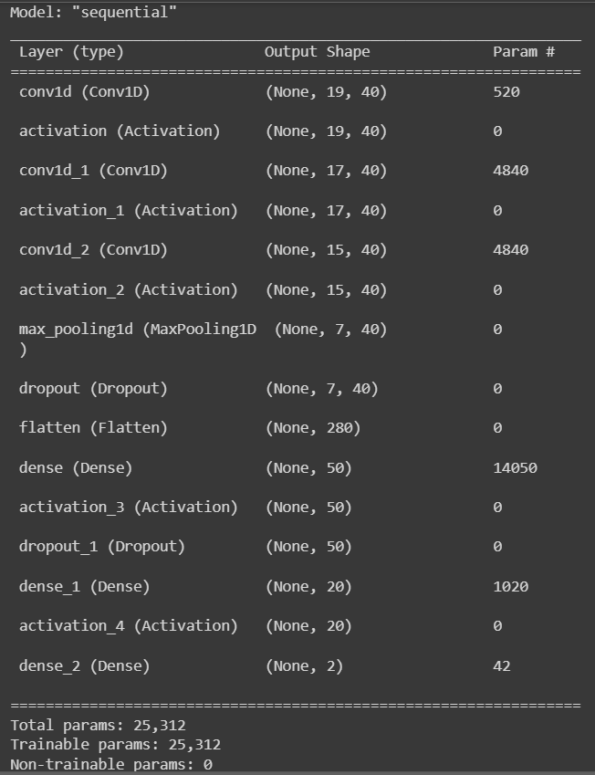
Convolutional Neural Network – CNN:
Has three one-dimensional convolutional layers and two full-connected layers.
The convolutional layers are the primary building block of a CNN that has 40 filters with size three and stride 1, without zero-padding, followed by an activation layer.
The consequent feature maps are fully connected to 50 units, again connected to 20 units.
A MaxPooling1D layer to downsample the input representation by pool_size of 2.
A Dropout layer is added, to randomly select neurons and ignore during training so that the network becomes less sensitive to specific weights.
A Flatten layer to flatten the input without affecting the batch size.
A dense layer, then activation, dropout, and again dense, followed by activation layers, are created.
A SoftMax layer is added, which outputs the units corresponding to the two levels of the predicted variable by converting the vector of values into a probability distribution.

Slide 9
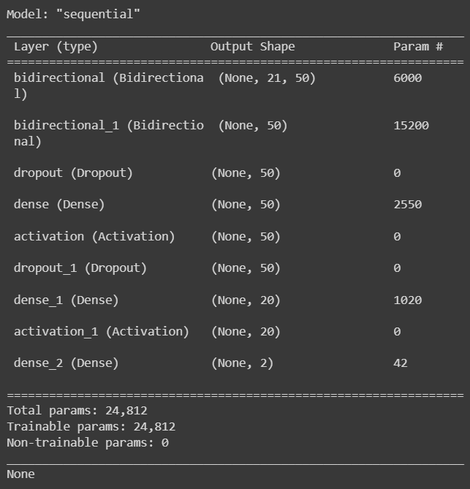
Recurrent Neural Network – RNN:
Two Bidirectional LSTM layers are used here for better performance as LSTM (Long Short-Term Memory) helps to remember the inputs for a long time.
Bidirectional trains two LSTMs instead of one for quicker results and complete learning on the problem.
The model consists of two bidirectional layers, where each LSTM cell consists of 25 hidden units.
The return sequence is marked true so that the output of the hidden state is used as input to the next LSTM layer.
A dropout layer follows it. The rest is done the same way as it is for the CNN model.
A dense layer, activation, dropout, dense and activation layers are included.
A dense layer with SoftMax is used to output the units of the corresponding predicted variables.

Slide 10
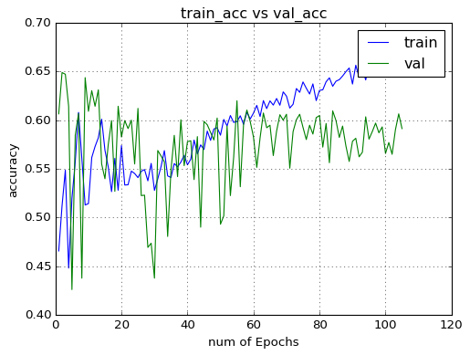
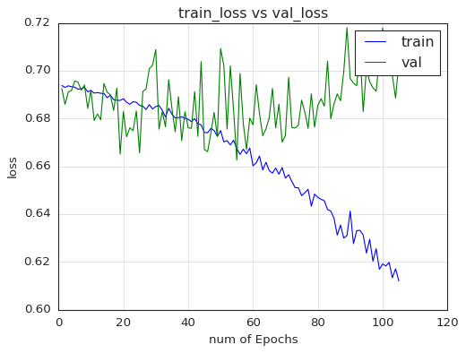
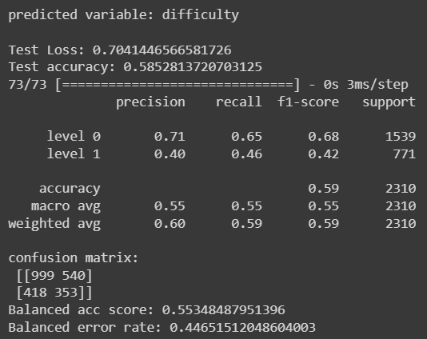
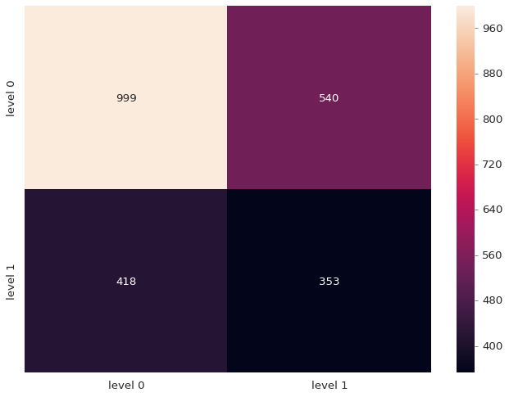
CNN for Difficulty
Predicting on
New Reading Windows
The test accuracy = 0.59%

Slide 11
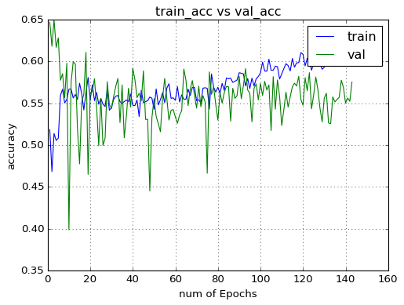
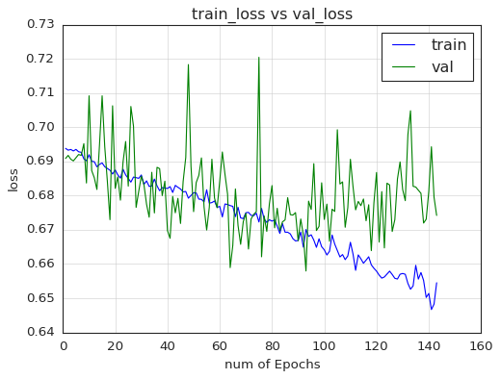
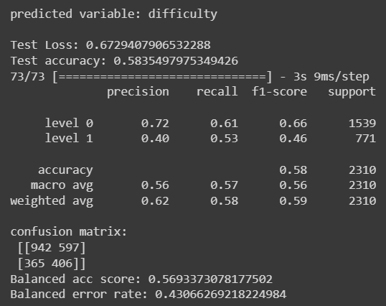
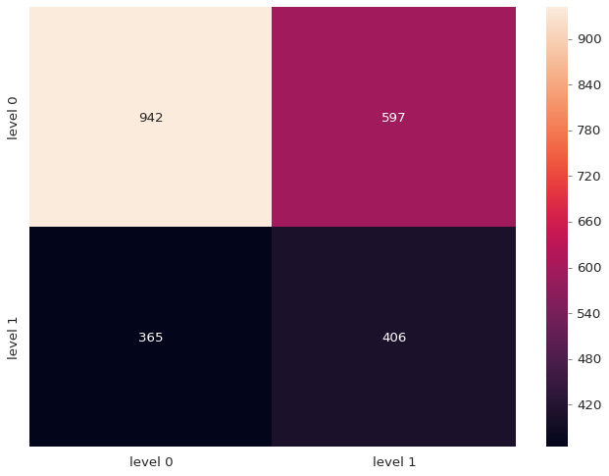
RNN for Difficulty
The test accuracy = 0.58%

Slide 12
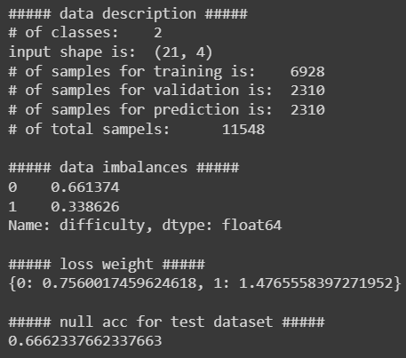
The null accuracy of the difficulty variable is 0.67%.
From the above, it can be seen that the accuracies of both CNN and RNN model are near the null accuracy but below it.

Slide 13
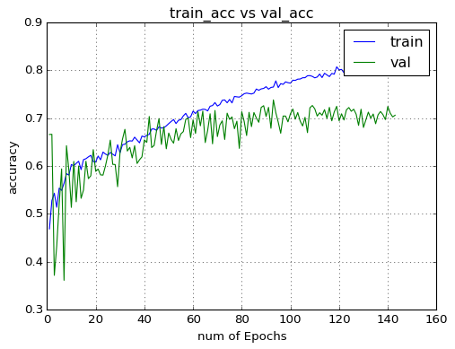
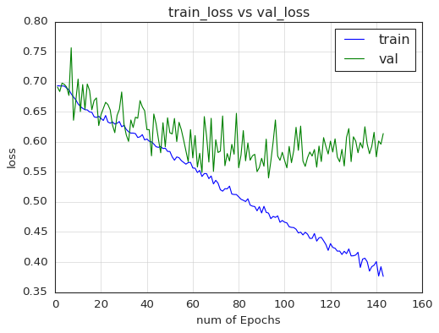
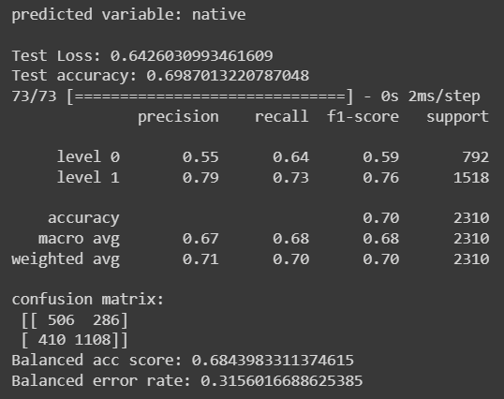
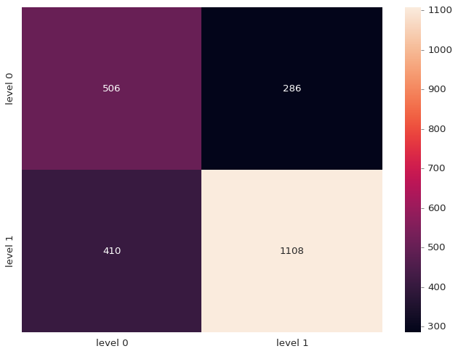
CNN for Native
The test accuracy = 0.70%

Slide 14
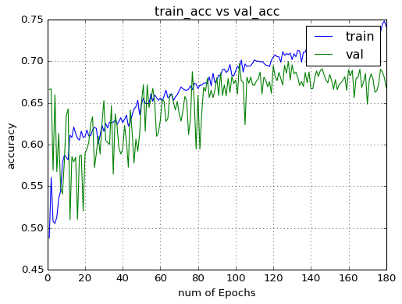
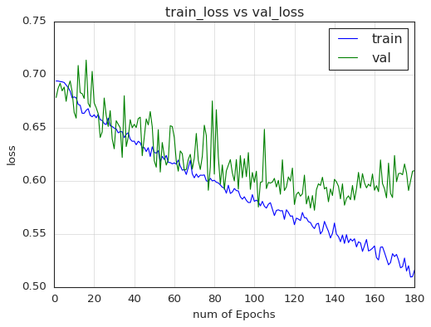
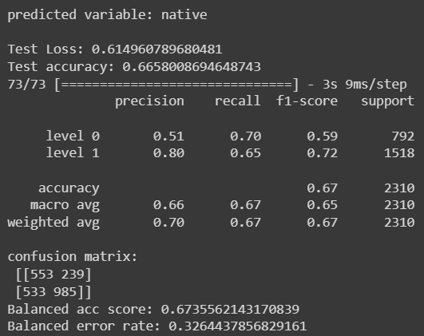
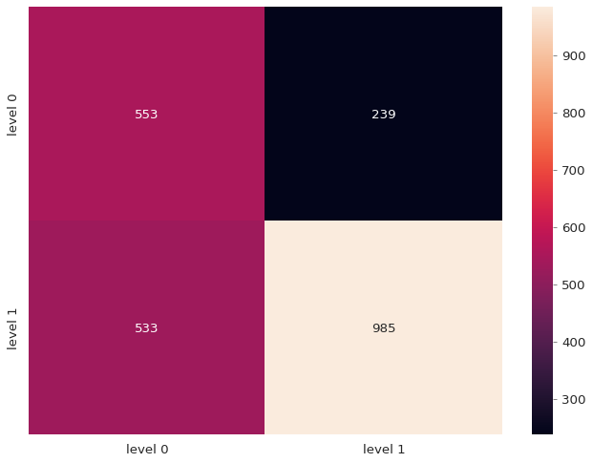
RNN for Native
The test accuracy = 0.67%

Slide 15
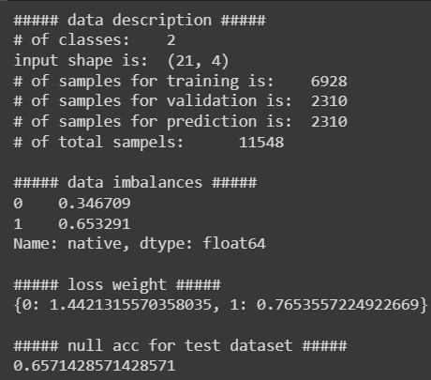
The null accuracy of the native variable is 0.66%
From the above, both the models CNN and RNN perform above the null accuracy. It is also seen that performance of CNN is better when compared to RNN.

Slide 16
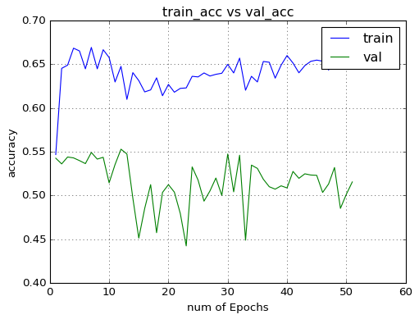
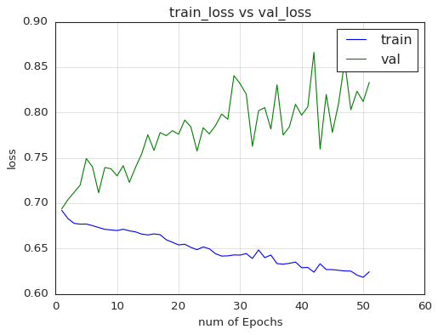
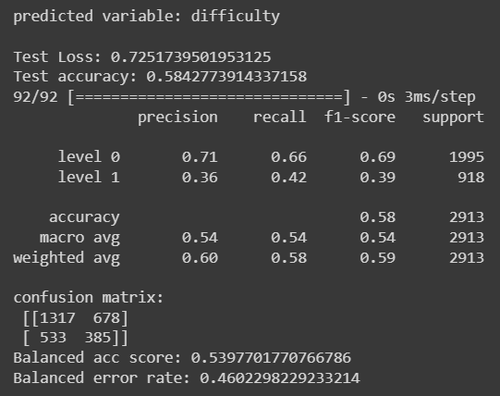
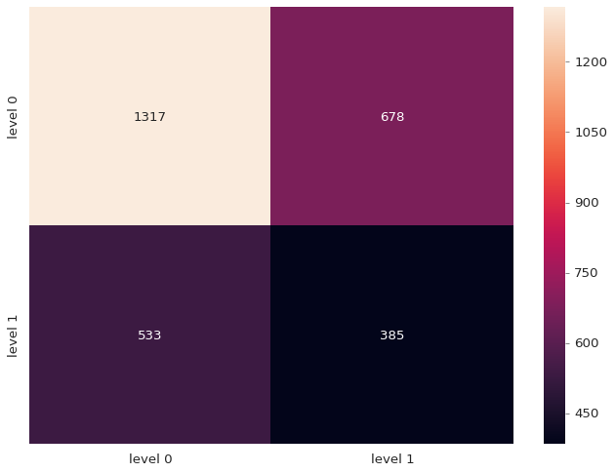
CNN for Difficulty
Predicting on
New Passages
The test accuracy = 0.58%

Slide 17
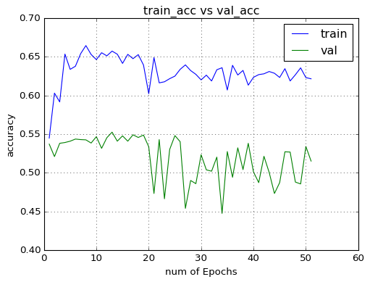
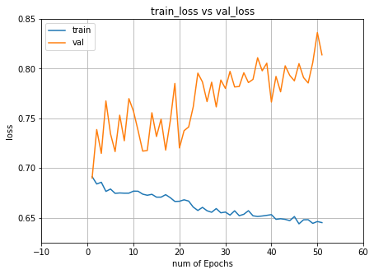
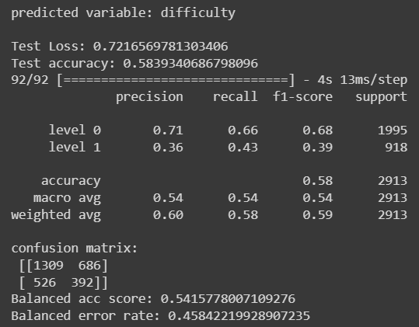

RNN for Difficulty
The test accuracy = 0.58%

Slide 18
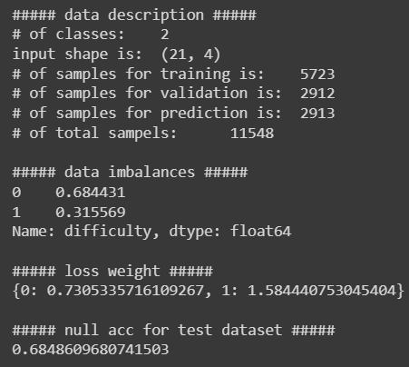
The null accuracy of the difficulty variable is 0.69%
From the above, it can be seen that the performance of both the models CNN and RNN is below the null accuracy.

Slide 19
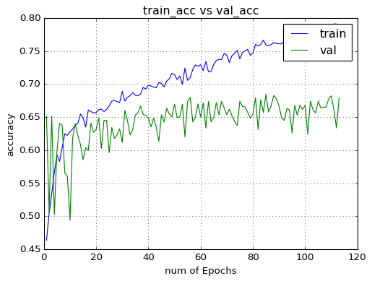
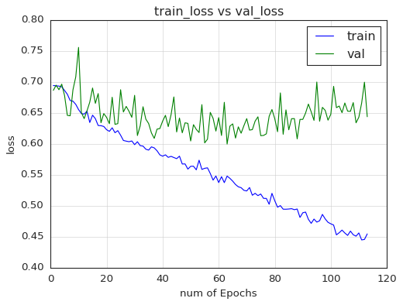
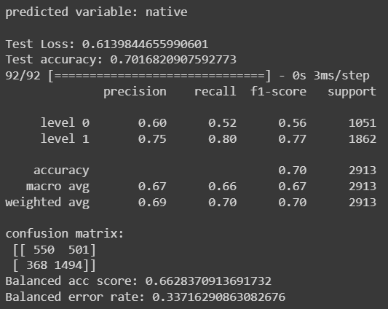
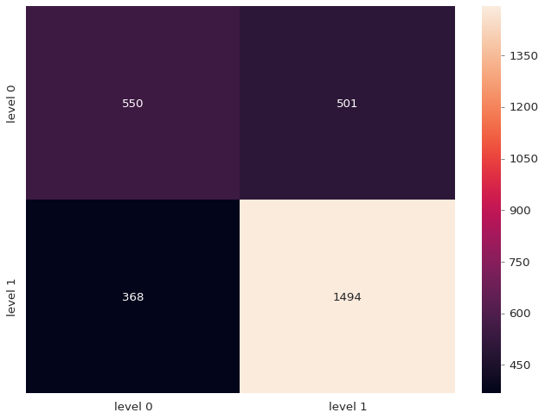
CNN for Native
The test accuracy = 0.70%

Slide 20
RNN for Native
The test accuracy = 0.65%

Slide 21
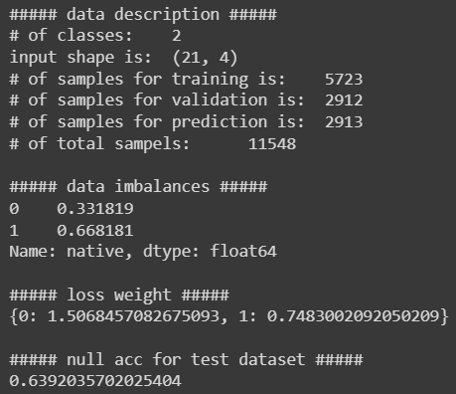
The null accuracy of the native variable is 0.64%
From the above, it can be seen that the accuracies of both the models CNN and RNN are above the null accuracy. It is noted that CNN model gives better performance compared to RNN model.

Slide 22
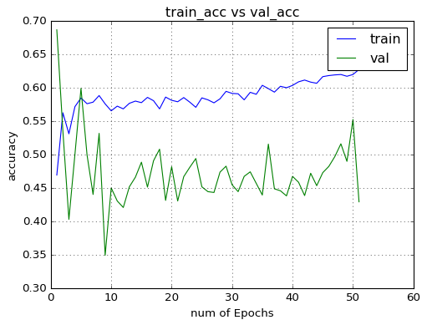
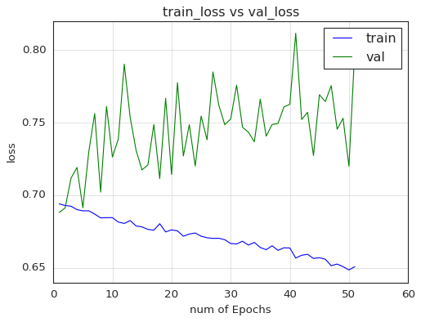
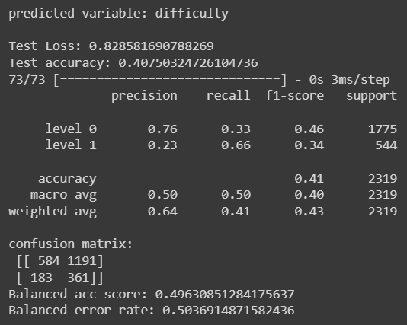
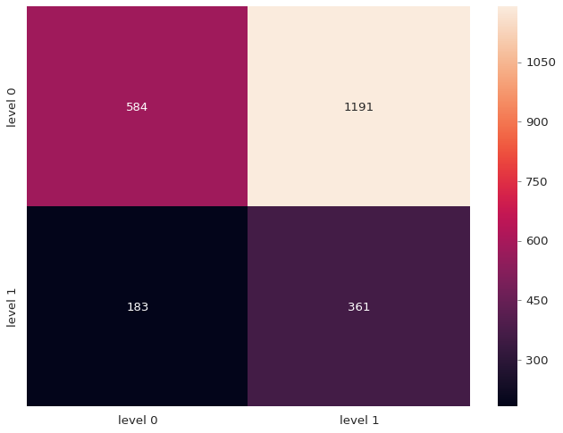
CNN for Difficulty
Predicting on New Readers
The test accuracy = 0.41%

Slide 23
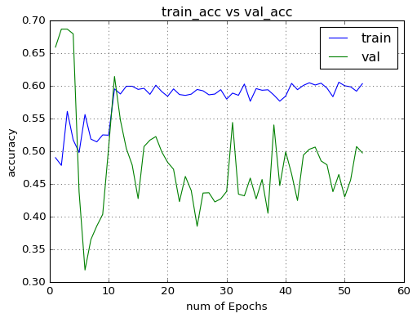
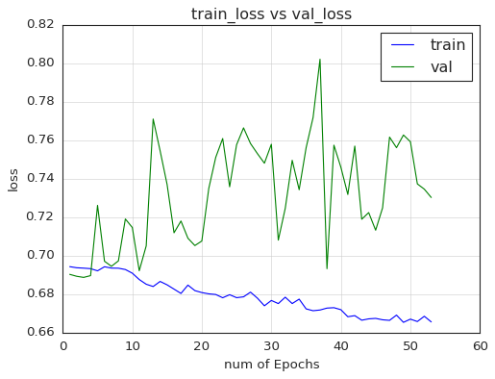
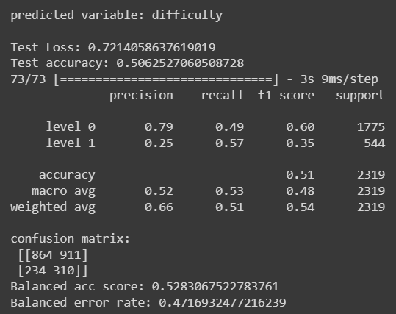
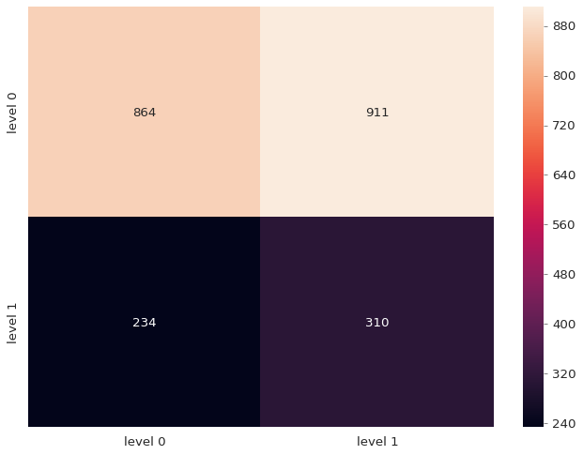
RNN for Difficulty
The test accuracy = 0.51%

Slide 24
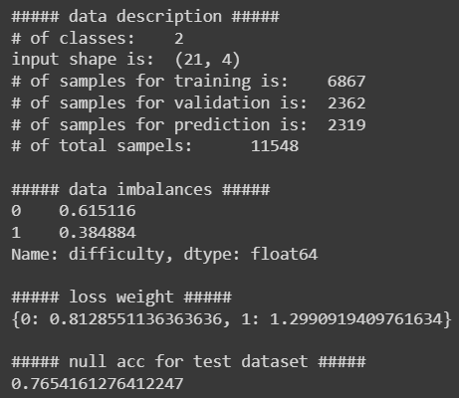
The null accuracy for the difficulty variable is 0.77%
From the above, it can be seen that both the models accuracies are below the null accuracy.

Slide 25
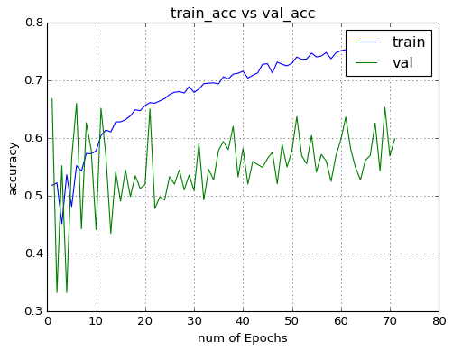
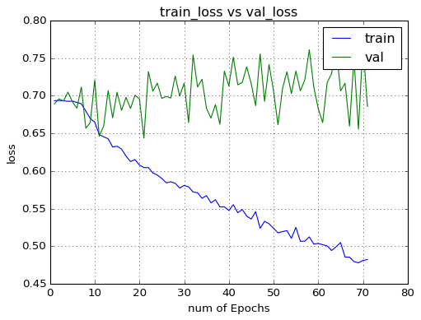
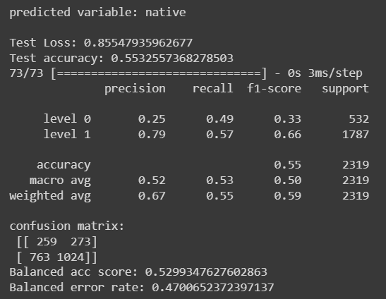
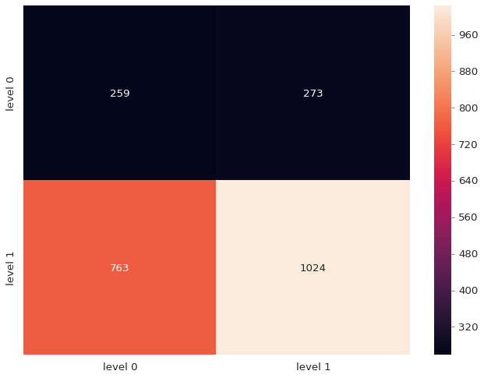
CNN for Native
The test accuracy = 0.55%

Slide 26
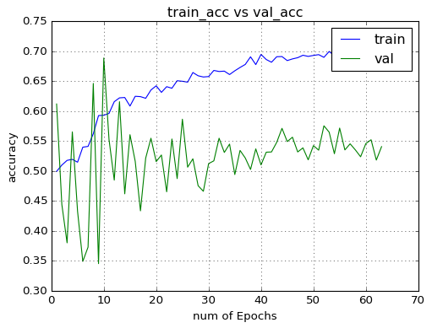
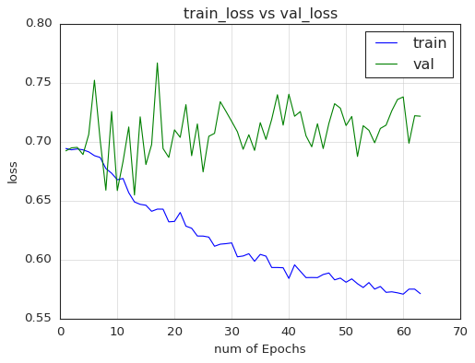
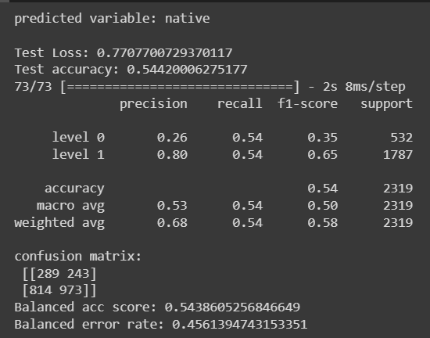
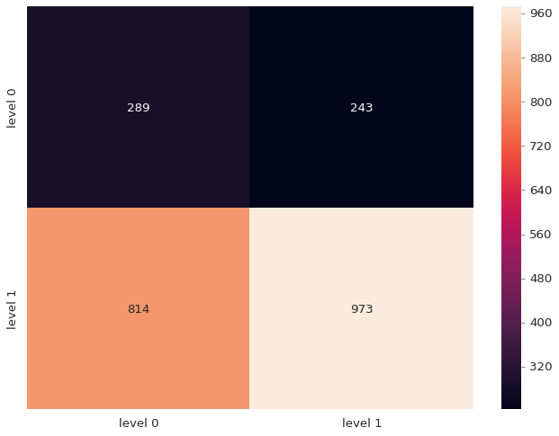
RNN for Native
The test accuracy = 0.54%

Slide 27

The null accuracy for the native variable is 0.77%
From the above, it can be seen that accuracies of both the models CNN and RNN is way below the null accuracy. The performance is poor.

Slide 28
Conclusion
The model is built to study and analyze approaches to classify a reader's comprehension level and worked on two prediction variables: the reader's difficulty and whether the reader is a native speaker of English.
It is observed that prediction on new passages and prediction on new reading windows for native variables gives better performance when compared to difficulty variables. The CNN model worked well in most cases compared to the RNN model. Predictions on new readers for difficulty and native are very poor.
There is still a lot of advancement to be done for the model thus, this problem needs to be worked upon.
The model shows the difference in statistical testing and prediction. Though the model could not perform well, it still predicted accuracies with some success rate.
Thus, these models are being used in various fields, and every improvement in the predictions can make a significant difference in diverse contexts.

Slide 29
Discussion
There is a lot to improve in the model's working. The models gave good accuracies in some cases, while they performed poorly in others.
It is also observed that the CNN model works better than the RNN model in many of the points.
The major limitation of this approach is the assumption that ground truth labels are assigned to local fixation windows based on the passage-level labels. A feasible solution to solve this problem can be to learn a weighting of local features that optimizes global prediction.
A study is already going on on this issue to construct reading detectors without using explicit ground truth labels for local fixation windows.
It is an assumption that the inclusion of lexical features could also improve the performance of the models.
The training, validation, and testing datasets for the same preliminary dataset differed; the resulting accuracies varied. Thus, the accuracies listed here may not be optimal.
Most of cases, the accuracies obtained are below the null accuracy. Still, these models' performance needs to be improved and is to be worked upon.

Slide 30
Thank you

